Slide 1

Ledcontroller
Pieter Brouns

Slide 2
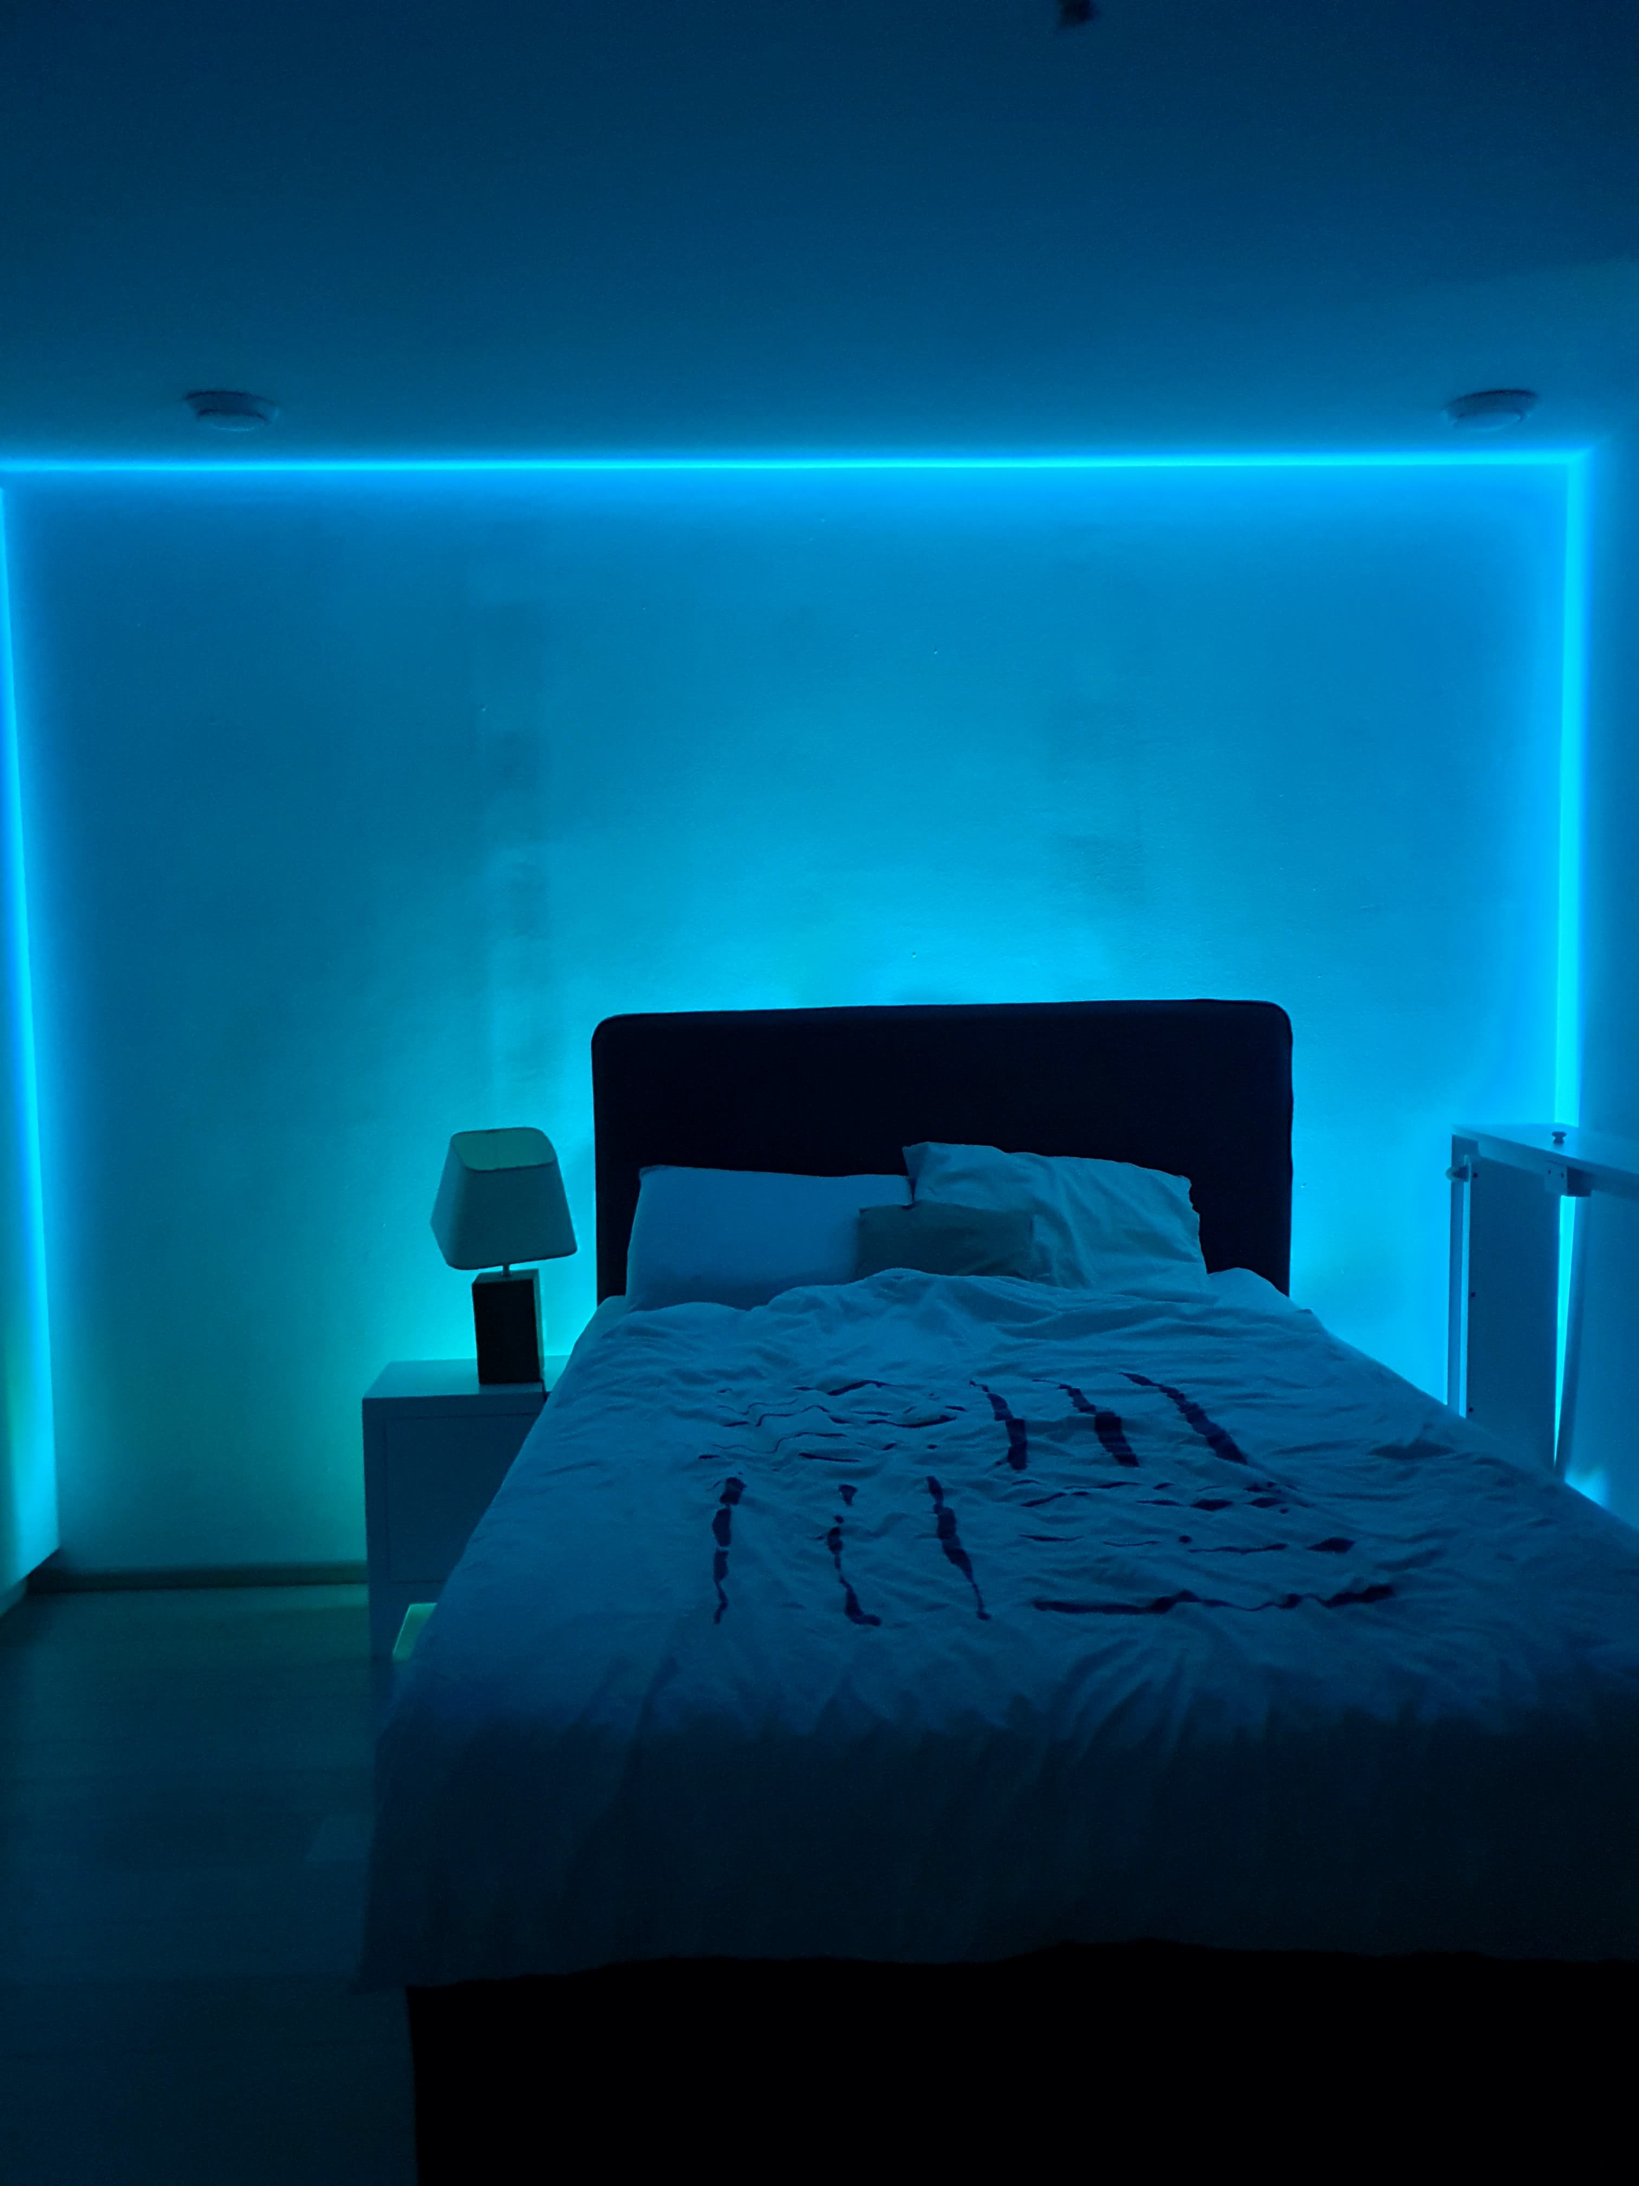
Introduction
Wireless control
All colors in RGB-spectrum
3 Ledstrips
Brother’s room

Slide 3

How does it work?

Slide 4
ESP-01

Slide 5
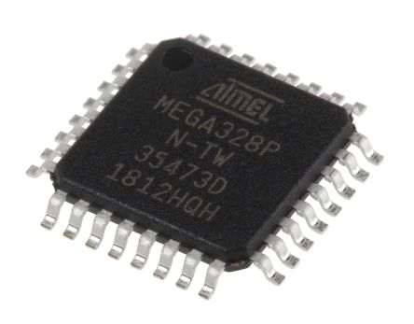
ATmega328P

Slide 6
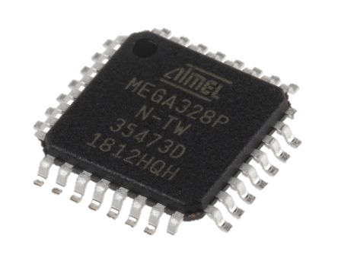

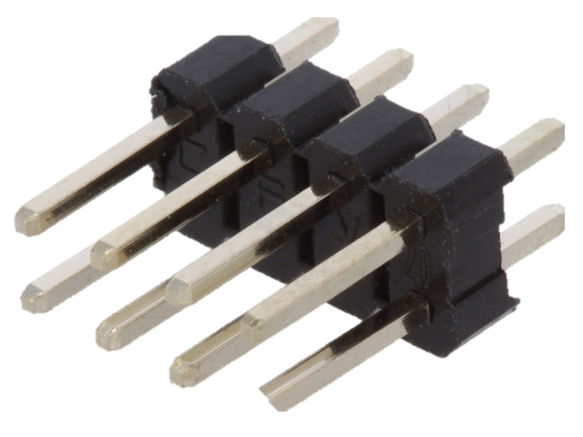
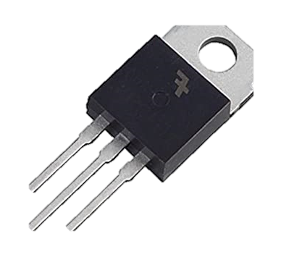
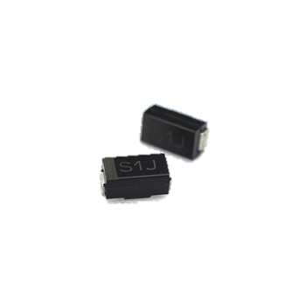
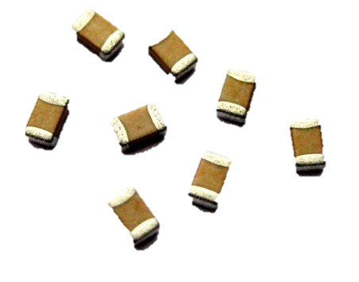
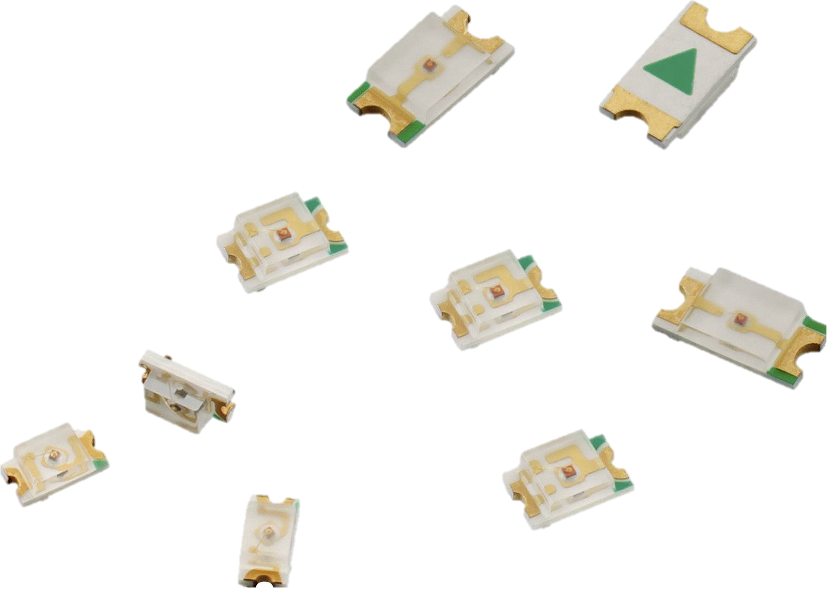
All the rest
Resistors
Headers
Leds
Voltage regulator
Diodes
Capacitors

Slide 7
BOM
Components | Amount | Price
PCB | 5 | € 30,79
ESP-01 | 1 | € 4,02
ATmega328P-AU | 1 | € 17,90
Ceramic capacitor | 2 | € 1,12
Elektrolytic capacitor | 2 | € 0,32
LD1117D Voltage Regulator | 1 | € 0,41
NDT3055L MOSFET | 9 | € 5,91
S1A Rectifier | 10 | € 1,29
DC Power Connector | 1 | € 1,78
4x2 header | 1 | € 1,20
Fixed Terminal Block | 6 | € 4,50
2x3 header | 1 | € 0,25
Green smd LED | 1 | € 0,16
Yellow smd LED | 1 | € 0,16
9x1 header | 1 | € 1,33
 |  | € 71,14

Slide 8
Problems
Schematics
Ordering
Case
PCB layout

Slide 9
References
Elektor magazine november/december 2016
Mouser.be

